Slide 1
Ready To Retire
Missouri Consolidated Health Care Plan

Slide 2
Disclaimer
Employees may participate in an MCHCP plan at retirement if eligible to receive a monthly retirement benefit from either the Missouri State Employees' Retirement System (MOSERS) or another retirement system whose members are grandfathered for coverage under the plan by law.
MCHCP members who are employees of a state-sponsored college or university covered under the Plan should check with their employer to see if MCHCP retiree coverage is included as a benefit to employees.

Slide 3
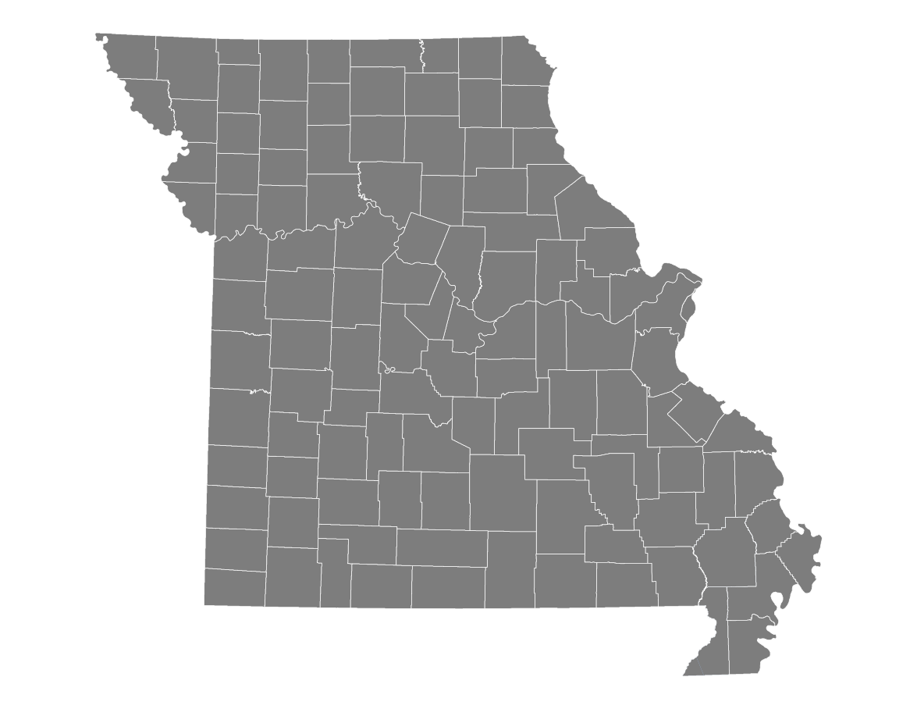
Missouri Consolidated Health Care Plan (MCHCP)
MCHCP
PO Box 104355
Jefferson City, MO 65110
www.mchcp.org
Meredith Curry
Education Specialist
Member Services: 800-487-0771
Jody Tellman
Education Specialist

Slide 4
MCHCP provides coverage to employees and retirees of MOST state agencies
Active state employees and non-Medicare retirees – HSA, PPO 750 and PPO 1250 medical plans with a commercial prescription drug plan
Military members – Option of TRICARE Supplement plan (Note: They will need to contact Selman and Co. to see if they are eligible.)
Retired members with Medicare – Group Medicare Advantage PPO plan with Part D prescription drug plan
MCHCP also administers dental and vision benefits, and the SELF program
MCHCP members who are employees of a state-sponsored college or university covered under the Plan should check with their employer to see if MCHCP retiree coverage is included as a benefit to employees.

Slide 5
Retire with MCHCP in 3 Steps:
Step 1 – Determine Options
Step 2 – Determine Premiums/Prepayment Option
Step 3 – Complete Retiree Enrollment
Coverage Changes After Retirement
MCHCP and Medicare
Resources and Reminders
We’ll also discuss:

Slide 6
Step 1 - Determine Options

Slide 7
Continue or Enroll in Coverage
Retirees and their dependents may continue their existing coverage OR may enroll in coverage with:
proof of other coverage for six months immediately prior to retirement; and
proof of eligibility for dependents, such as a birth certificate or marriage license.
If you choose NOT TO continue or enroll in coverage, you have lost the opportunity to have MCHCP coverage in retirement.

Slide 8
Transfer Coverage
Retirees may transfer to their spouse’s MCHCP coverage at retirement.
Members can transfer back to their own coverage later if the coverage is continuous.
MCHCP DOES NOT administer medical plans for MoDOT, the Missouri Department of Conservation or the Missouri State Highway Patrol.

Slide 9
Cancel Coverage
Retirees can elect to cancel ALL OR PARTS of their coverage.
Retirees who cancel or fail to elect coverage for themselves or their dependents CANNOT re-enroll later (unless otherwise eligible).

Slide 10
Step 2 – Determine Premiums/Prepayment Option

Slide 11
MCHCP’s Contribution
(Number of FULL YEARS of Service) x 2.5% (as reported by MOSERS)
Maximum contribution is capped at 65% (26 years of service).
Non-Medicare retiree contribution is based on PPO 1250 Plan with both Strive for Wellness® incentives.
Medicare retiree contribution is based on the Medicare Advantage Plan total premium.
Contribution is subject to change each year.

Slide 12
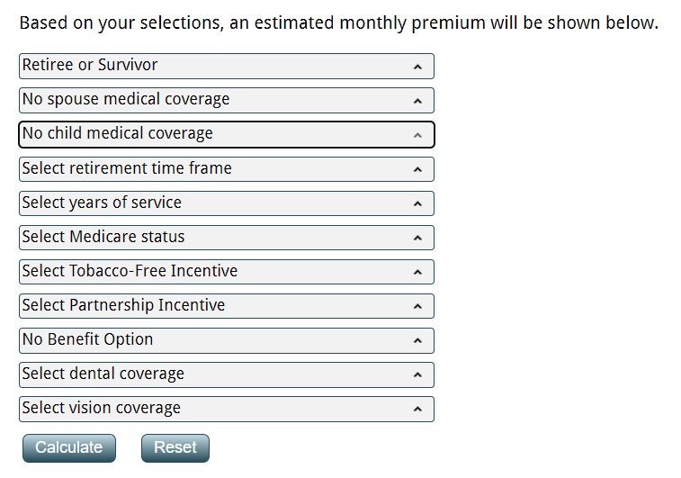
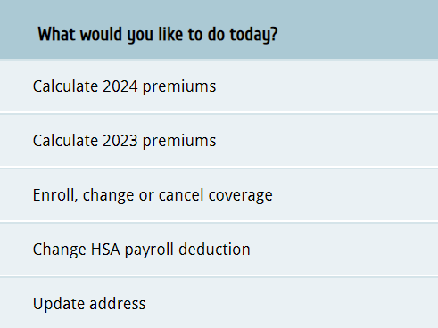
Premium Calculator
1) Log into myMCHCP. Under the What would you like to do today? menu, select Calculate 2024 premiums.
2) Use the drop-down boxes to input your criteria.
3) Select Calculate to get your monthly premiums.

Slide 13
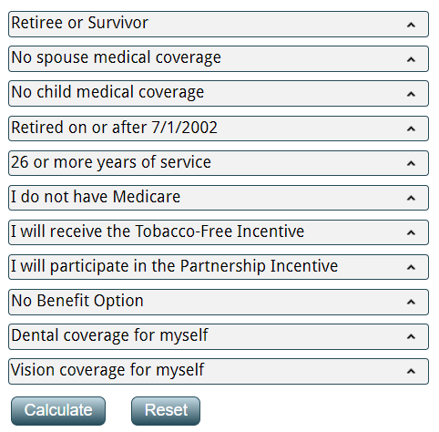
Non-Medicare Premium Calculator Example
Non-Medicare retiree
Participating in both incentives
26+ years of service
Subscriber-only coverage
Calculated Monthly Premiums
Plan Description | Level of Coverage | Total Plan Premium | MCHCP Contribution | Subscriber Pays
HSA Plan Anthem | Subscriber Only | 1,010.00 | 701.00 | 244.00*
PPO 1250 Plan Anthem | Subscriber Only | 1,144.00 | 701.00 | 378.00*
PPO 750 Plan Anthem | Subscriber Only | 1,210.00 | 701.00 | 444.00*
TRICARE Supplement | Subscriber Only | 60.50 |  | 60.50
MetLife Dental | Subscriber Only | 26.90 |  | 26.90
NVA Basic Plan | Subscriber Only | 3.43 |  | 3.43
NVA Premium Plan | Subscriber Only | 4.33 |  | 4.33
*Non-Medicare retirees can still participate in the Partnership and Tobacco-Free incentives.

Slide 14
Medicare Retiree Premium Calculator Example
Medicare retiree
26+ years of service
Subscriber-only coverage
Calculated Monthly Premiums
Plan Description | Level of Coverage | Total Plan Premium | MCHCP Contribution | Subscriber Pays
Medicare Advantage Plan | Subscriber Only | 235.00 | 139.00 | 82.00
MetLife Dental | Subscriber Only | 26.90 |  | 26.90
NVA Basic Plan | Subscriber Only | 3.43 |  | 3.43
NVA Premium Plan | Subscriber Only | 4.33 |  | 4.33
*Medicare retirees are NOT eligible for the Tobacco or Partnership incentives.

Slide 15
Prepayment Option
Cafeteria plan ends at retirement.
Employees may be eligible to prepay premiums pretax through the end of the year in which they retire.
HR/Payroll reps can determine worth of annual leave/compensatory time/holiday payouts.
Retiree’s first month of premiums is divided between last two active paychecks.
EXCEPTIONS
Opted out of the Cafeteria Plan’s Premium-Only Participation
Dec. 1 retirement date
Transferred to active state spouse’s plan

Slide 16
Prepayment Example
July 1 Retirement | July’s Premium
Monthly retiree premium of $378 divided in half and deducted from last two active paychecks.
June 30 | $189
July 15 | $189
Used annual leave payout to prepay Aug.-Dec. premiums pretax.
August | $378
September | $378
October | $378
November | $378
December | $378
Total Prepay Amount $378 x 5 = $1,890
*Default for premium collection is MOSERS retirement benefit payment

Slide 17
Step 3 – Complete Retiree Enrollment

Slide 18
Submit Your Retiree Enrollment Form
To ensure a smooth transition, submit at least 60 days in advance of your retirement.
Medicare-eligible? Submit a copy of your Medicare card showing enrollment in Medicare Parts A & B.
Preferred Method: Submit the Retiree Enrollment Form online through myMCHCP.
Deadline is 31 days after your retirement date.

Slide 19
Coverage Changes After Retirement

Slide 20
MCHCP Coverage Changes
31 days from the event date to enroll
Marriage
Birth
60 days from the date coverage is lost to enroll
Involuntary loss of employer-sponsored group coverage
Adoption
Placement of a child
Use Open Enrollment (Oct. 1–31 each year) to update existing coverage. However, as a retiree, you can no longer elect new coverages or add dependents during this time.
Dependents may be added when there is a qualifying life event.
Provide proof of eligibility (e.g., birth certificate, marriage license).
Medical plans may be changed when adding dependents due to a qualifying life event.
Medicare-eligible dependents will be enrolled in the Medicare plans.

Slide 21
Survivor Coverage
Survivors covered at the time of a retiree’s death may elect to continue coverage.
Medicare members
Coverage automatically continues
Non-Medicare members
Complete MCHCP’s Survivor Enrollment Form (31 days)

Slide 22
MCHCP and Medicare

Slide 23
Medicare
The Social Security Administration (SSA) administers Medicare Parts A and B.
MCHCP’s Medicare Advantage Plan includes Parts C and D coverage and is only available to Medicare-eligible retirees.
You MUST be enrolled in Medicare Parts A & B and pay your Part B premium.
Active employees may opt out of Medicare Part B until their retirement.
Contact SSA 3 to 4 months prior to your retirement date to enroll in Medicare Part B.
Insurance
PART A
Hospital Insurance
PART B
Medical Insurance
PART C
Medicare Advantage
PART D
Prescription Drug

Slide 24
Medicare-Eligible Retiree
Submit a copy of your Medicare card to MCHCP upon receipt.
To ensure a smooth transition, submit 60 days in advance.
Medicare-eligible retired members are automatically enrolled in the UnitedHealthcare (UHC) Group Medicare Advantage Plan (Part C) & Express Scripts Medicare (Part D) prescription drug plan.
Non-Medicare members and/or dependents remain in a non-Medicare MCHCP plan.
Premiums will be adjusted based on Medicare status.

Slide 25
Medicare Advantage Plan (Part C)
Customized plan for Missouri state retirees
UnitedHealthcare (UHC) administers
Group Medicare Advantage PPO plan
Nationwide coverage
Preventive Care – covered at 100%
Copayments for majority of services
$15 for PCP
$30 for specialists
$1,500 yearly out-of-pocket maximum

Slide 26
Additional Programs
Virtual Visits
HouseCalls
Annual Wellness Visit
Renew Active® by UnitedHealthcare®
UnitedHealthcare® Healthy at Home
Rally® Coach
UnitedHealthcare Hearing
Vision

Slide 27
Prescription Drug Plan (Part D)
Express Scripts Medicare administers the prescription drug plan.
Medicare members are automatically enrolled.
Fill prescriptions at any nationwide network, or by using home delivery.
Must pay copayments for preferred generic or brand, or non-preferred drugs.
There is no donut hole.
There is no additional premium. (It’s included in the Medicare Advantage Plan!)

Slide 28
Medicare Advantage Plan Tips
DO NOT enroll in another Medicare Advantage, Medigap, Medicare Supplement or another Medicare Part D plan.
You may contact Missouri SHIP at 800-390-3330, or visit www.missouriship.org, for free, unbiased, confidential Medicare counseling and education.
For questions regarding Medicare, call 1-800-MEDICARE or visit www.medicare.gov.

Slide 29
Resources and Reminders

Slide 30
Additional eForms available on myMCHCP

Slide 31
Reminders
Complete enrollment (preferably within 60 days of retirement date) and submit a copy of your Medicare card (if eligible).
Retirees who completed the Retiree Enrollment DO NOT need to complete the COBRA packet.
Non-Medicare retirees not enrolled in TRICARE may continue the Strive for Wellness® incentives.
The Strive Employee Life and Family (SELF) Program continues for 18 months after retirement.
Oct. 1–31 is Open Enrollment each year. Review your plans to make necessary changes.
Always keep your contact information up-to-date with MCHCP.
If you do not enroll at retirement, or if you cancel coverage as a retiree, you cannot enroll later.

Slide 32
Eligibility/Enrollment, premiums, change of address, name change or general benefit questions.
Plan contact information can be found on our website or in your Enrollment Guide.

